Slide 1
CISC2003 OOP AND DATA STRUCTURES
1
Lab 7
TA: Zhang Wenyuan
yc07421@um.edu.mo
E11-2016
Notes:
Chapter 1 - 1

Slide 2
Outline
2
Get familiar with Recursion programming technique.
Notes:
Chapter 1 - 2

Slide 3
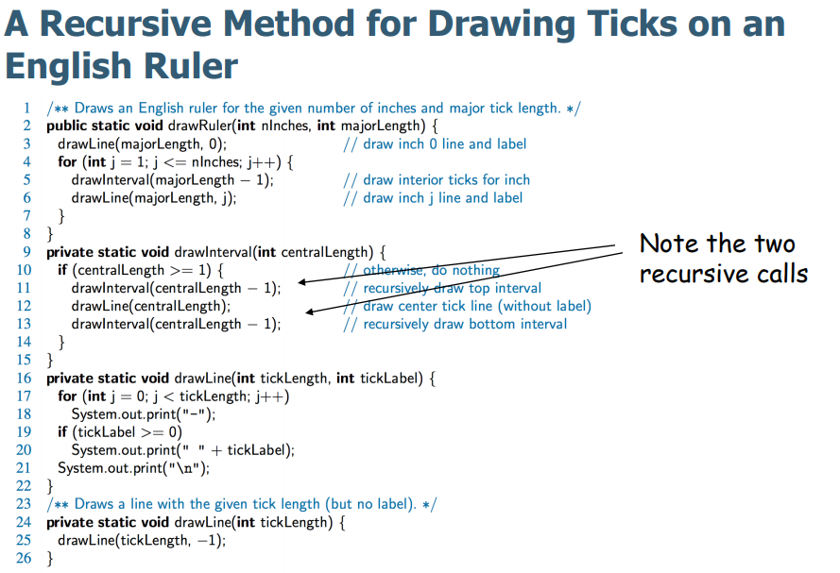
Practice
3
Using the code in lecture notes, implement drawing the English ruler.
Notes:
Chapter 1 - 3

Slide 4
Exercise
4
Using binary recursion and linear recursion to implement the Computing Fibonacci Numbers, respectively.
Submission Guideline
1. Please submit .java file and screenshot to UMMoodle.
2. Do not copy your classmate’s codes, otherwise both of you will lose scores.
3.Submission deadline: 11:50pm, 9/11/2022.
(It will better if you can submit at the end of this lab.)
Notes:
Chapter 1 - 4

